Slide 1
ONLINE NEWS PORTAL
JOE JOSEPH
INMCA S7
Rollno:35
Notes:
Are your classroom colors different than what you see in this template? That’s OK! Click on Design -> Variants (the down arrow) -> Pick the color scheme that works for you!
Feel free to change any “You will…” and “I will…” statements to ensure they align with your classroom procedures and rules!
<number>

Slide 2
The Existing system.
Newspapers are the conventional and widely used mode for getting people with daily news. What happens is a newspaper boy delivers the newspapers daily to the customers. People get to know the daily news from these papers. Television news channels and social medias also helps to bring news but it is the newspapers which plays the major role.

Slide 3
Disadvantages
A newspaper to reach our homes daily is not an easy task. It sometimes comes late or it sometimes does not even come. Also the weather conditions such as rains may also affect the system badly. At the same time, the paper used to make 1000s of tons of newspapers daily which comes from the cut down trees is never an environment safe idea.

Slide 4
THE PROPOSED SYSTEM
What the proposed system is just as simple as an online news delivering system or an online news portal in technical terms. Daily news from all areas ranging from international to local areas will be available online. Anyone could login to the site and access the news.

Slide 5
ADVANTAGES
-Free Of Cost.
-Available 24/7
-Could be accessed from anywhere via an internet-device
-More people to the world of internet.
-No environmental issues.

Slide 6
DISADVANTAGES
-Requires a computer, laptop or smartphone with an internet connection.
-People without computer knowledge cannot use the system

Slide 7
TABLE DESIGNS
tbl_login
tbl_localnews
Serial no | Field Name | Description | Data Type
1 | loginid | Primary key | Int
2 | Username |  | varchar
3 | password |  | Password
Serial no | Field Name | Description | Data Type
1 | l_newsid | Primary key | int
2 | galid | Foreign key | int
3 | B_headline |  | varchar
4 | B_content |  | Varchar
tbl_reg
Serial no | Field Name | Description | Data Type
1 | Regid | Primary key | Int
2 | loginid | Foreign key | int
3 | name |  | Varchar
4 | gender |  | varchar
5 | email |  | Varchar
6 | phoneno |  | Number

Slide 8
Tbl_intnews
Serial no | Field Name | Description | Data Type
1 | I_newsid | Primary key | int
2 | galid | Foreign key | int
3 | I_headline |  | varchar
4 | I_Content |  | Varchar
tbl_gallery
Serial no | Field Name | Description | Data Type
1 | galid | Primary key | int
3 | image |  | varchar
4 | video |  | varchar

Slide 9
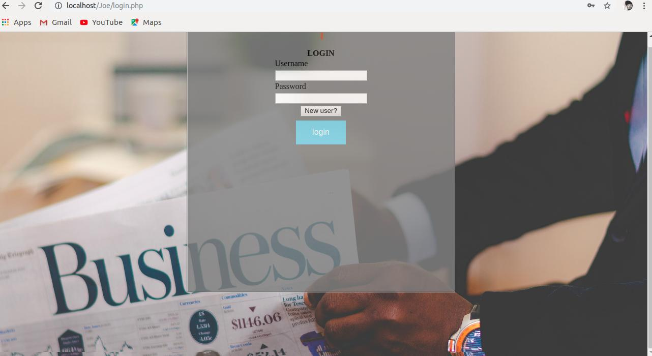
LOGIN PAGE

Slide 10
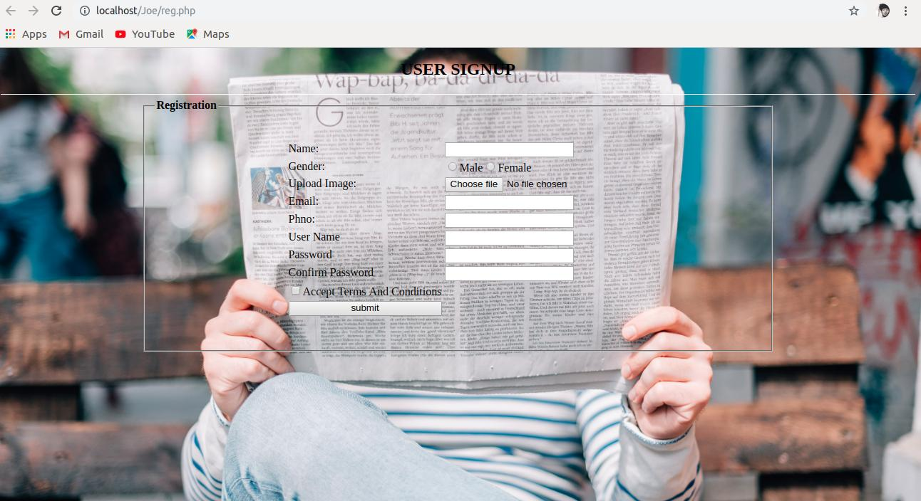
REGISTRATION PAGE

Slide 11
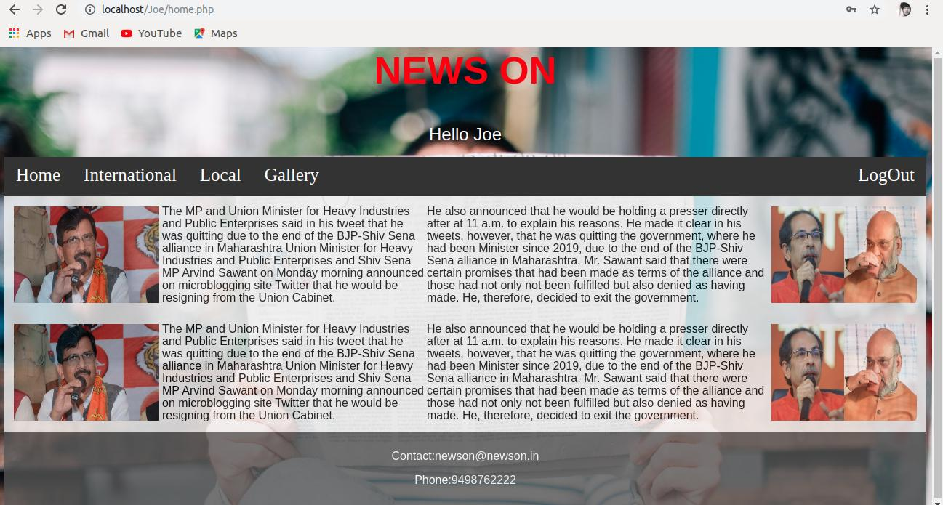
HOME PAGE

Slide 12
THANK YOU :)

